Slide 1

MULTIPLE, INNOVATIVE, REDCAP PROJECTS FOR TWO SIMULTANEOUS MULTICENTER TRIALS
Charity G. Patterson, PhD, MSPH
Alexandra Gil, PhD
Bob Winners
James Irrgang, PhD
University of Pittsburgh
STaR TRIAL
Surgical Timing and Rehabilitation
After Multiligament Knee Injuries

Slide 2

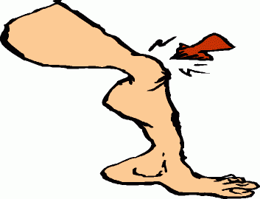
STaR Trials
N=392
Early Surgery – Early Rehabilitation
MLKI
Early Surgery – Delayed Rehabilitation
< 6 weeks?
Delayed Surgery – Early Rehabilitation
Delayed Surgery – Delayed Rehabilitation
N=298
> 6 weeks?
Early Rehabilitation
This Photo by Unknown Author is licensed under CC BY-NC-ND
Delayed Rehabilitation

Slide 3
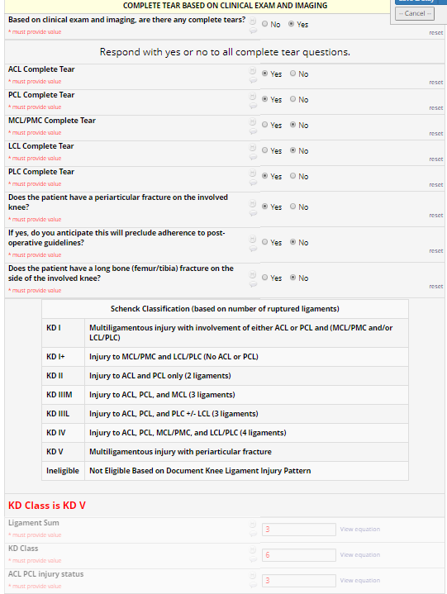
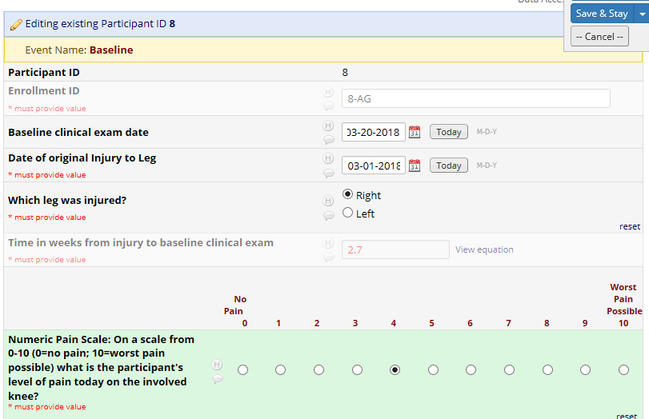
Baseline Clinical Exam
(ensuring eligibility)

Slide 4
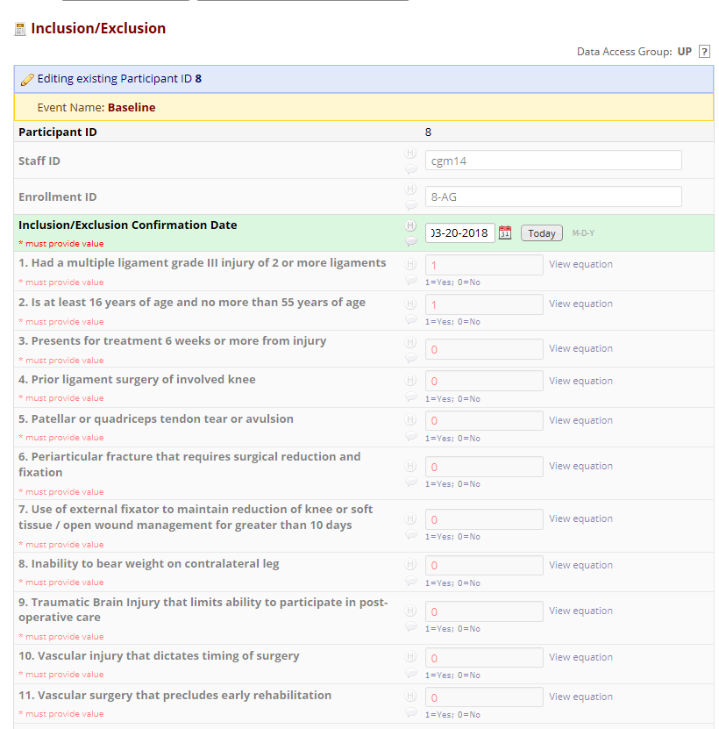
Preventing Randomization of Ineligible Subjects
“smart” I/E

Slide 5
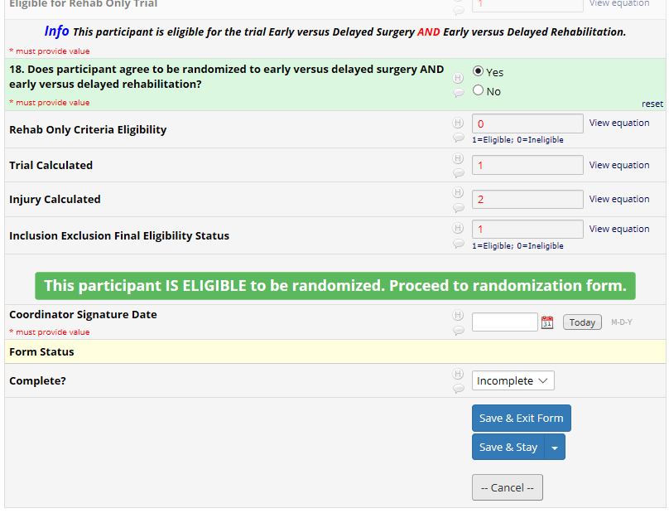
I/E Criteria

Slide 6
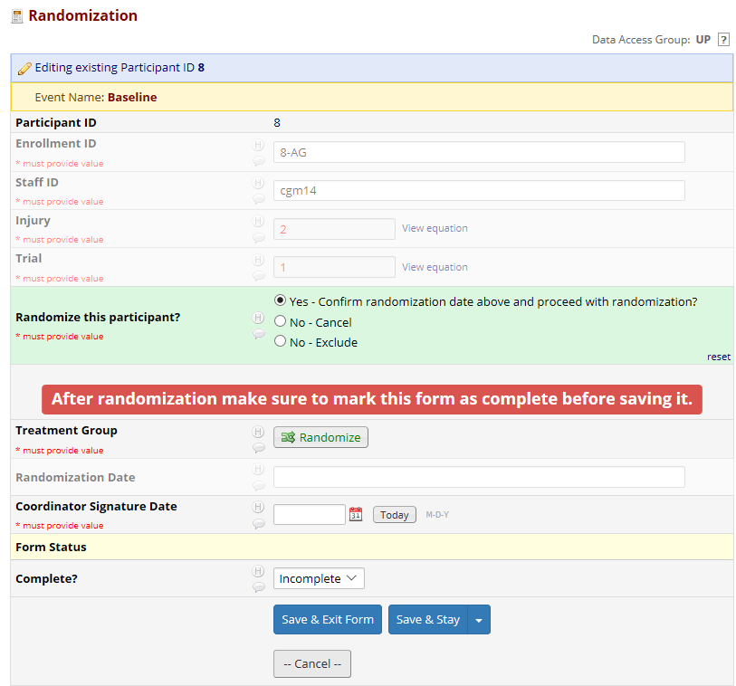
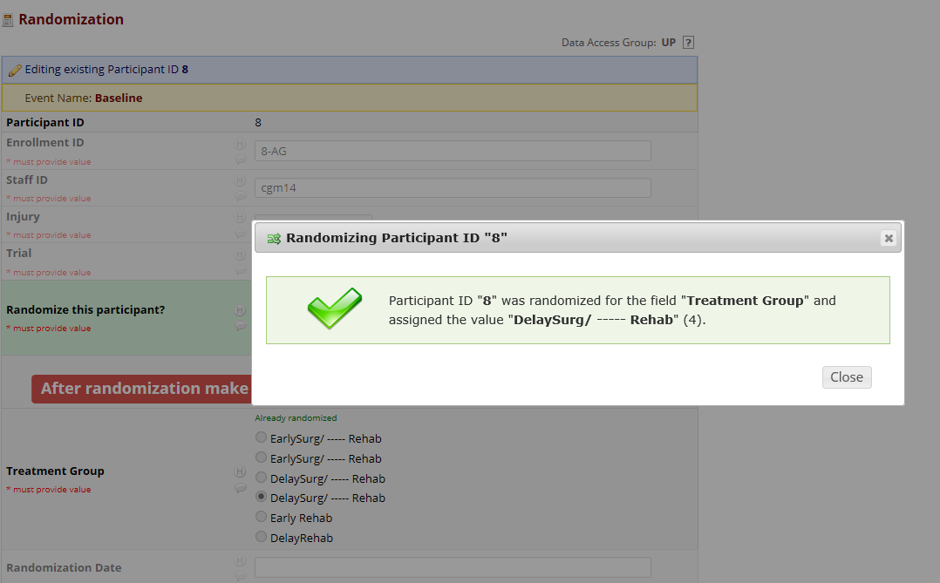
Allocation Concealment for Surgery Trial (2x2)
Note: Rehabilitation arm is NOT disclosed

Slide 7
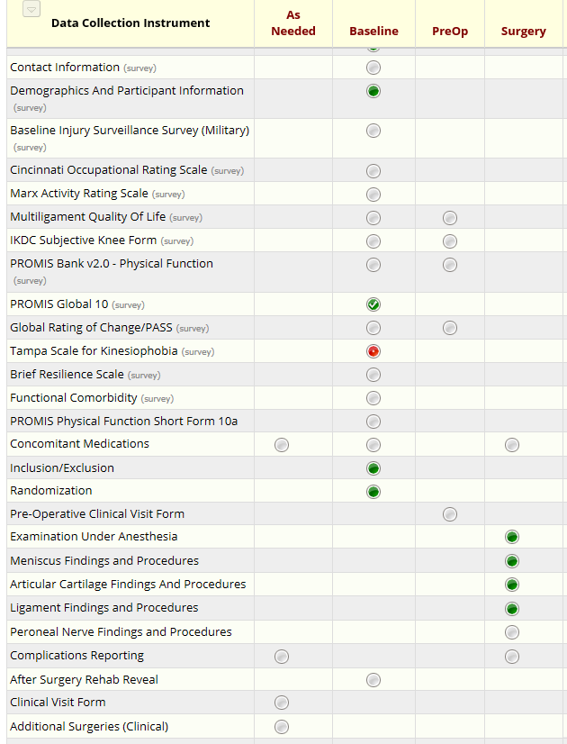
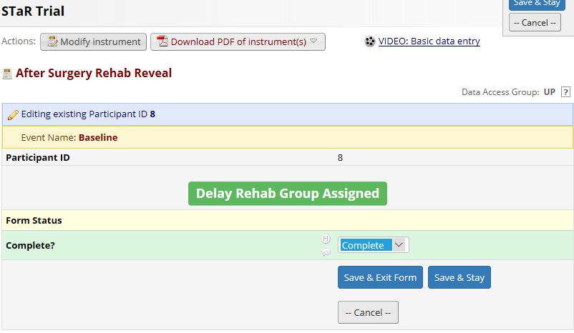
After Surgery Rehab Reveal for 2x2

Slide 8
Multiple Ligament Knee Injury (MLKI)
Timing of Surgery and Rehab
Pre-Screening for Study Eligibility
Timing of Rehab Only
Subject within 6 weeks after injury
Subject > 6 weeks after injury or
NOT eligible for Timing of Surgery
Sign Inform Consent Document
Screening for Study Eligibility
Baseline Patient-Reported Outcomes
Randomization
Early Surgery &
Early Rehab
Delayed Surgery &
Early Rehab
Early Surgery &
Delayed Rehab
Delayed Surgery &
Delayed Rehab
Early
Rehab
Delayed Rehab
Completed
In-person at the Clinical Site
Visits record data related to clinical outcome
  Range of Motion
  Ligament Exam
  Complications – AEs/SAEs
  Adherence to rehabilitation as randomized
  Additional Surgeries - clinical
Surgery
Completed Remotely and conducted by staff at University of Pittsburgh
(Canadian Sites Responsible for their own follow-up)
Return to Activity Monitoring
Patient Reported Outcomes
Clinical Visits
Patient-Reported Rehab Activity
[In-person visit]
Research Visits
Patient Self-Reported Outcomes
[Computer-based/Web-based]
1 week
Post-Surgery
6 Months
Post-Randomization
4-6 Weeks
Post-Surgery
Monthly: 7 to 11 months
Post-Randomization
3 Months
Post-Surgery
12 Months
Post-Randomization
6 months
Post-Surgery
Monthly: 13 to 23 months
Post-Randomization
9-12 Months
Post-Surgery
24 Months
Post-Randomization

Slide 9
Multiple Ligament Knee Injury (MLKI)
Timing of Surgery and Rehab
Timing of Rehab Only
Pre-Screening for Study Eligibility
Subject within 6 weeks after injury
Subject > 6 weeks after injury or
NOT eligible for Timing of Surgery
N=392
N=298
Sign Inform Consent Document
Screening for Study Eligibility
Baseline Patient-Reported Outcomes
Randomization
Early Surgery &
Early Rehab
Delayed Surgery &
Early Rehab
Early Surgery &
Delayed Rehab
Delayed Surgery &
Delayed Rehab
Early
Rehab
Delayed Rehab
Completed
In-person at the Clinical Site
Visits record data related to clinical outcome
  Range of Motion
  Ligament Exam
  Complications – AEs/SAEs
  Adherence to rehabilitation as randomized
  Additional Surgeries - clinical
Surgery
Completed Remotely and conducted by staff at University of Pittsburgh
(Canadian Sites Responsible for their own follow-up)
Return to Activity Monitoring
Patient Reported Outcomes
Clinical Visits
Patient-Reported Rehab Activity
[In-person visit]
Research Visits
Patient Self-Reported Outcomes
[Computer-based/Web-based]
1 week
Post-Surgery
6 Months
Post-Randomization
1 Month
Post-Surgery
Monthly: 7 to 11 months
Post-Randomization
3 Months
Post-Surgery
12 Months
Post-Randomization
6 months
Post-Surgery
Monthly: 13 to 23 months
Post-Randomization
9-12 Months
Post-Surgery
24 Months
Post-Randomization

Slide 10
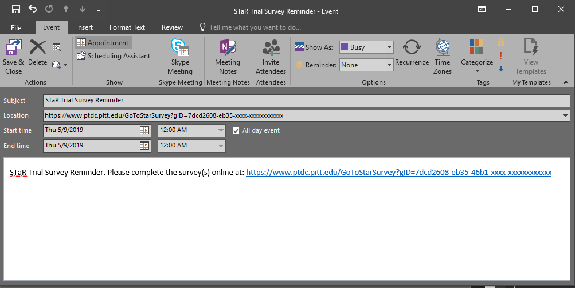
Internet Calendaring and Scheduling
Optimizing Centralized Research Follow-Up

Slide 11
ICS Survey Reminders – Technical Algorithm
Participant
REDCap Server
Step 3: Sends survey message with link where ICS file can be download is based on the GUID.
REDCap API
Step 1: After randomization REDCap sends to the application.
Step 2: Application sends REDCap GUID for PID.
Step 4: follows link to download ICS file
Server hosting Custom Web Application (.NET)
Step 5: Client is prompted to add reminder to calendar
SQL Database
Notes:
The ICS (Internet Calendaring and Scheduling Core Object Specification) is supported by various products: Microsoft Outlook, Google Calendar, Apple Calendar, Android and IOS built in calendar apps
GUID stands for Globally Unique Identifier. It is a special 128-bit number that is generated to create a unique value.
It is used in STaR because I had to create a unique value that would be hard for others to guess. This is important because someone should not be able to simply edit a URL to modify or view someone else’s information.

Slide 12
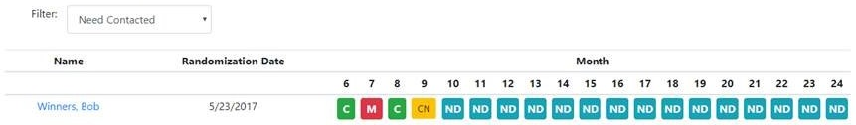
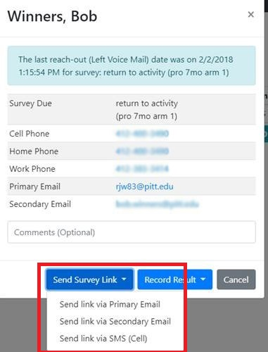
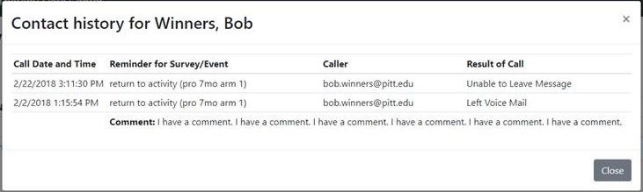
Follow-up Dashboard

Slide 13
Follow-up dashboard - Technical Algorithm
Participant
Step 6: Receives link-Completes survey.
REDCap Server
REDCap API
Step 2: contact participant.
SMTP (email) or Twilio (sms)
Step 4: Identify survey
Coordinator
Step 1: Identify participants on dashboard
Step 5: Send link or SMS.
Server hosting Custom Web Application (.NET)
Step 3: Send survey link via email or SMS.
SQL Database

Slide 14
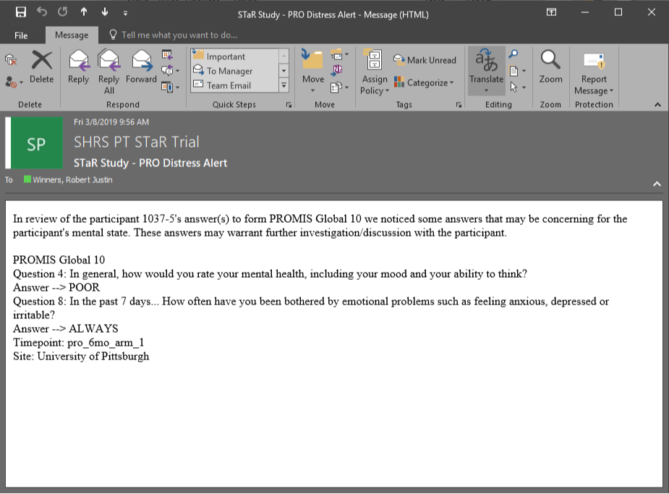
How do we monitor for safety with remote surveys???

Slide 15
E-mail alert triggers – Technical Algorithm
Participant
REDCap Server
Step 1: Indicates distress on survey.
REDCap API
Step 2: All survey data sent. Application will look for endorsement of depression symptoms
Step 3: Sends alert via e-mail (or SMS)
CCC and Site
Coordinators
SMTP (email) or Twilio (sms)
Server hosting Custom Web Application (.NET)
SQL Database

Slide 16
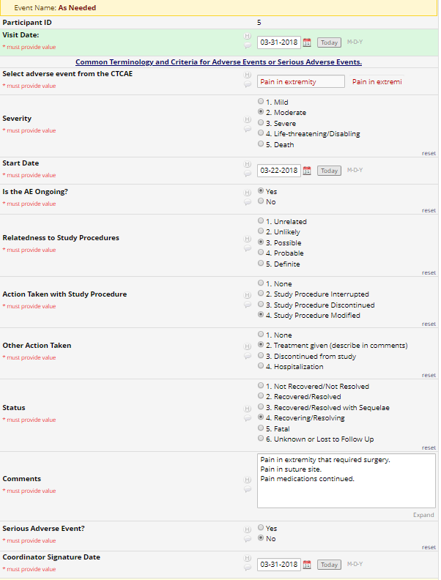
Adverse Event Adjudication

Slide 17
Adverse Event Adjudication – Technical Algorithm
Coordinator
REDCap Server
Step 1: New AE or edit.
REDCap API
Step 3: List of AEs which need to be internally adjudicated
Step 2: Sent to application. The AE is stored in the SQL Database.
Investigator or External Committee
Step 4: Adjudicates. All actions are saved.
Step 5: List of AEs to be externally adjudicated.
Server hosting Custom Web Application (.NET)
Step 6: Adjudicates. All actions are saved.
SQL Database

Slide 18
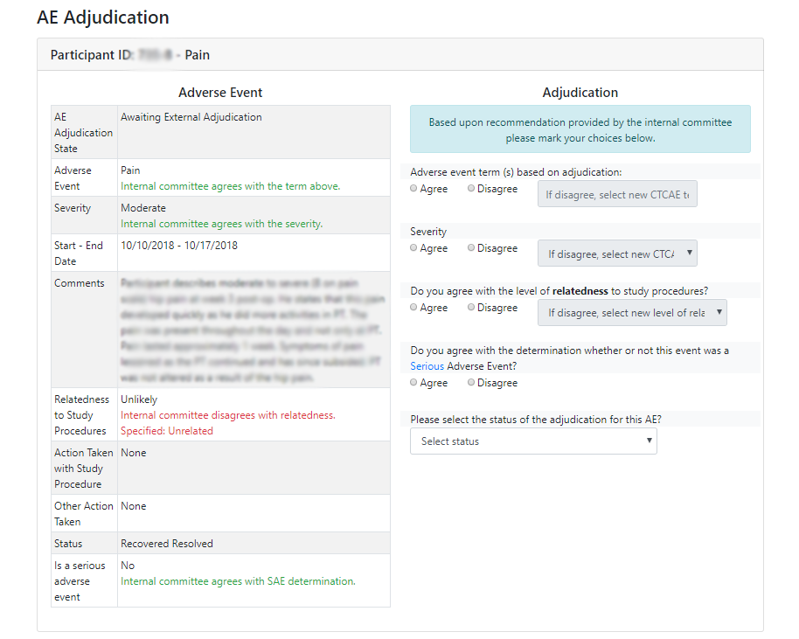
Adverse Event
Adjudication

Slide 19
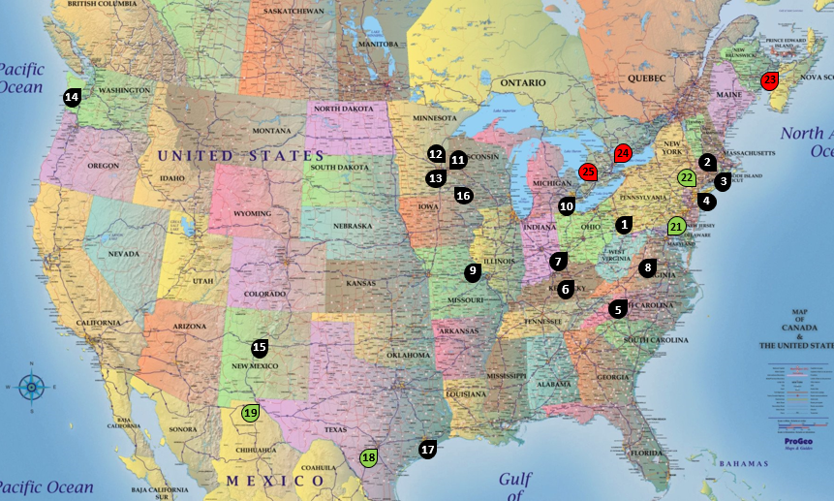
Multilingual forms

Slide 20
Multilingual forms - Technical Algorithm
Coordinator
REDCap Server
Step 1: Creates record noting Spanish language.
REDCap API
Step 2: Participant’s preferred language.
Step 3: If Spanish, creates record in Spanish project via REDCap API.
Step 6: Sends Spanish survey. App populates English project via REDCap API.
Step 4: Goes to Spanish project, puts in Survey Mode.
Participant
Server hosting Custom Web Application (.NET)
Step 5: Participant fills out Spanish surveys.
SQL Database

Slide 21
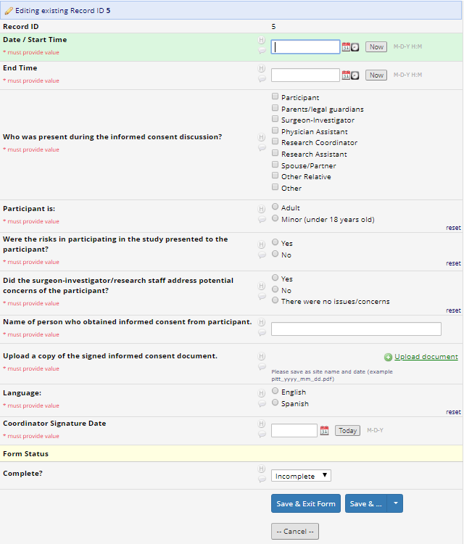
Clinical Monitoring:
Consent project
Central IRB
Remote monitoring!!!
CCC and DCC to monitor 100%
Documents IC process
Ensures human subjects protection

Slide 22
Summary
Powerful tool that we have successfully used for 2 large trials
  Clinical Project
  Research Follow-Up Project
  Spanish Version Projects
  Consent Project
Maximized use of Application Programming Interface (API)
Advantage of REDCap – easy to export architecture for Canadian site
Some restrictions we could not make
Interested in others experiences

Slide 23
Thank you!
Questions?
Bob Winners
Bob.winners@pitt.edu
Charity G. Patterson, PhD, MSPH
cgp22@pitt.edu
Alexandra Gil, PhD
agil@pitt.edu
University of Pittsburgh

Slide 24
Extra slides

Slide 25
STaR Trial – Study Flow Diagram
Rehabilitation Only
Clinical Visits
(# of fields for each form in RedCap)
Subjects with MLKI - Surgeon’s office
Surgery
Research Visits
Subject within 6 weeks after injury
Subject > 6 weeks after injury OR
NOT eligible for Timing of surgery
Timeline from SURGERY – Standard of Care Clinical Visits
As Needed Forms
7.a. Adverse Events with SAE
7.a. Serious Adverse Events
AEs Internal Committee Review
AEs Adjudication Committee Review
7.b. Change in Status
7.c. Protocol Deviation
Unanticipated Problems
3 MONTHS
6 MONTHS
9-12 MONTHS
4.h. Clinical Visit form (154)
4.j. Additional Surgeries (clinical) (21)
4.l. Concomitant Medications (13)
5.a. Physical Therapy Case Report (39)
5.b. Patient Reported Rehabilitation (36)
5.c. Complications Reporting (12) *
4.h. Clinical Visit form (154)
4.j. Additional Surgeries (clinical) (21)
4.l. Concomitant Medications (13)
5.a. Physical Therapy Case Report (39)
5.b. Patient Reported Rehabilitation (36)
5.c. Complications Reporting (12) *
4.h. Clinical Visit form (154)
4.j. Additional Surgeries (clinical) (21)
4.l. Concomitant Medications (13)
5.c. Complications Reporting (12) *
2.a. Initial Screening form (22) – given study ID
Sign Informed Consent
SCREENING
3.a. Contact Information (29)
3.b. Demographics and Participant Information (38)
3.b.2. Baseline Surveillance Survey/Military Activity (7)
2.b. Baseline Clinical Exam (89)
1 MONTH
4.h. Clinical Visit form (154)
4.j. Additional Surgeries (clinical) (21)
4.f. Complications Reporting (12) *
5.a. Physical Therapy Case Report (39)
5.b. Patient Reported Rehabilitation (36)
5.c. Post-Operative Home Exercise Log (97)
BASELINE
Timeline from RANDOMIZATION – PROs Completed Remotely for Research Purposes
3.b.1. Functional Comorbidity Index (22)
3.c. Cincinnati Occupational Rating Scale (9)
3.d. Marx Activity Rating Scale (6)
3.e. IKDC Subjective Knee Evaluation (21)
3.g. Multi-Ligament Quality of Life Questionnaire (54)
3.i. PROMIS Physical Function v.2 (4-12)
3.h. PROMIS Global 10 (10)
4.i. Global Rating of Change/PASS (4)
3.j. Tampa Scale for Kinesiophobia (17)
3.n. Brief Resilience Scale (6)
4.l. Concomitant Medications (13)
6 MONTHS
12 MONTHS
24 MONTHS
6.a. Return to Activity Monitoring Survey (11)
6.a.1. Return to Work Activity (4)
6.a.2. Return to Sports Activity (6)
6.a.3. Return to Military Activity (9)
3.c. Cincinnati Occupational Rating Scale (9)
3.d. Marx Activity Rating Scale (6)
3.e. IKDC Subjective Knee Evaluation (21)
3.g. Multi-Ligament Quality of Life Questionnaire (54)
3.l. PROMIS Physical Function v.2 (4-12)
3.h. PROMIS Global 10 (10)
3.j. Tampa Scale for Kinesiophobia (17)
4.i. Global Rating of Change/PASS (8)
4.k. Additional Surgeries – Patient Reported (9)
6.a. Return to Activity Monitoring Survey (11)
6.a.1. Return to Work Activity (4)
6.a.2. Return to Sports Activity (6)
6.a.3. Return to Military Activity (9)
3.c. Cincinnati Occupational Rating Scale (9)
3.d. Marx Activity Rating Scale (6)
3.e. IKDC Subjective Knee Evaluation (21)
3.g. Multi-Ligament Quality of Life Questionnaire (54)
3.l. PROMIS Physical Function v.2 (4-12)
3.h. PROMIS Global 10 (10)
3.j. Tampa Scale for Kinesiophobia (17)
4.i. Global Rating of Change/PASS (8)
4.k. Additional Surgeries – Patient Reported (9)
6.a. Return to Activity Monitoring Survey (11)
6.a.1. Return to Work Activity (4)
6.a.2. Return to Sports Activity (6)
6.a.3. Return to Military Activity (9)
3.c. Cincinnati Occupational Rating Scale (9)
3.d. Marx Activity Rating Scale (6)
3.e. IKDC Subjective Knee Evaluation (21)
3.g. Multi-Ligament Quality of Life Questionnaire (54)
3.l. PROMIS Physical Function v.2 (4-12)
3.h. PROMIS Global 10 (10)
3.j. Tampa Scale for Kinesiophobia (17)
4.i. Global Rating of Change/PASS (8)
4.k. Additional Surgeries – Patient Reported (9)
~ 1 WEEK FROM SURGERY
4.h. Clinical Visit form (154)
4.j. Additional Surgeries (clinical) (21)
4.l. Concomitant Medications (13)
5.c. Post-Operative Home Exercise Log (97)
4.f. Complications Reporting (12)
2.c. Inclusion/Exclusion Form (34)
Early Surgery & Early Rehab
Early Surgery & Delayed Rehab
Delayed Surgery & Early Rehab
Delayed Surgery & Delayed Rehab
Early Rehab
Delayed Rehab
If ELIGIBLE
12. Randomization Timing of Surgery
Cannot be randomized to timing of surgery
Randomization for Timing of Rehabilitation
Early Surgery
Delayed Surgery
Monthly: 7 – 11 MONTHS
Monthly: 13 – 23 MONTHS
6.a. Return to Activity Monitoring Survey (11)
6.a.1. Return to Work Activity (4)
6.a.2. Return to Sports Activity (6)
6.a.3. Return to Military Activity (9)
3.c. Cincinnati Occupational Rating Scale (9)
3.d. Marx Activity Rating Scale (6)
6.a. Return to Activity Monitoring Survey (11)
6.a.1. Return to Work Activity (4)
6.a.2. Return to Sports Activity (6)
6.a.3. Return to Military Activity (9)
3.c. Cincinnati Occupational Rating Scale (9)
3.d. Marx Activity Rating Scale (6)
SCHEDULE SURGERY
Day of SURGERY
Pre-op clinical visit form
4.a. Examination Under Anesthesia (EUA) (37)
4.b. Meniscus Findings and Procedures (18)
4.c. Articular Cartilage Findings and Procedures (29)
4.d. Ligament Findings and Procedures (158)
4.e. Peroneal Nerve Findings (4)
4.f. Complications Reporting (12)
IF SURGERY SCHEDULED > 4 weeks from baseline
PROs Pre-Operative
3. g. Multi-Ligament Quality of Life Questionnaire (54)
3.e. IKDC Subjective Knee Evaluation (21)
3.i. PROMIS PF v.2 (4-12)
4.i. Global Rating of Change/PASS (4)

Slide 26
ICS Survey Reminders – Technical Algorithm
Participant
REDCap Server
Step 5: The participant’s browser automatically follows the survey link (sent to it in Step 4) and retrieves the REDCap survey as normal.
REDCap API
Step 2: Application looks up PID for GUID, and calculates if it is indeed time to take the survey(s) based on randomization date. If not, send user an error message. If so, get REDCap survey link from REDCap server.
Step 3: REDCap sends application survey link for participant.
Step 1: Participant is reminded by their calendar application and follows link. The link has the participants GUID.
Server hosing Custom Web Application (.NET)
Step 4: Application responds with REDCap survey URL. The URL is wrapped in a URL redirect so that the participant’s browser automatically follows the link.
SQL Database

Slide 27
ICS Survey Reminders – Participant Usage
Participant’s calendar application reminds individual that it is time to take the survey.
Participant clicks on link within calendar application.
Participant is forwarded to proper survey in REDCap
The ICS file contains a date, description and link that the participant can click on to be forwarded to the proper survey.
  Link is unique to the participant and it is impossible to guess another participant’s link.
    Uses Globally Unique Identifier standard - 128-bit number – 1 out of 5,316,911,983,139,663,491,615,228,241,121,400,000 combinations (struck by lightning is 1 in 3,000)
    https://<hostname>/GoToSurvey?gid=a378790c-a22e-4be7-a0d0-35605e9c66e3
Prevents participants from clicking and being forwarded to the survey before the specified window.
In our current study, participants have used calendar reminders 50% of the time. (todo update this… right now 1 of 2 used it)

Slide 28
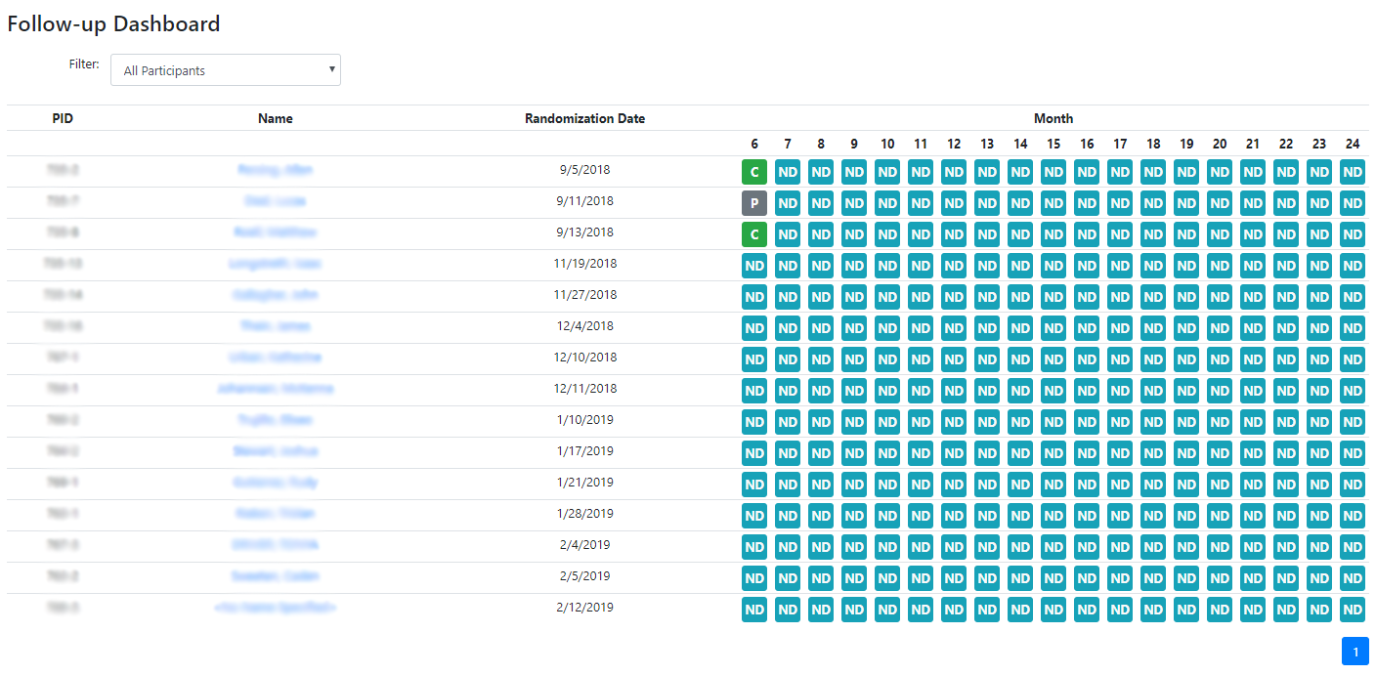
Follow-up dashboard
Allows coordinators an at-a-glace view of all participants to see which ones need to be contacted.

Slide 29
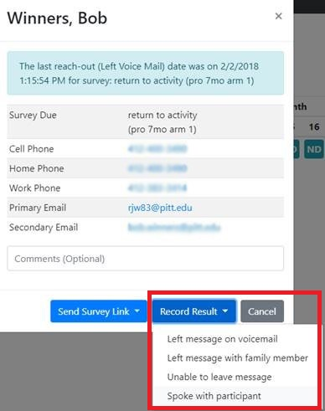
Follow-up dashboard
Keeps track of when the participant has been contacted so that multiple coordinators are not contacting the same participant within the same reminder period. The contact needed block (yellow) with turn back to pending (gray).
  For example, at a follow-up time point participants are to be reminded 2 days after due date, then again at 4 days after due date.

Slide 30
Follow-up dashboard - Technical Algorithm Pt. 1
Participant
REDCap Server
Step 2: Participant fills out surveys in REDCap.
REDCap API
Step 1: Upon randomization, REDCap sends the application participant contact information, randomization date, and participant id.
Step 3: When each survey is completed, REDCap notifies the application.
Server hosing Custom Web Application (.NET)
SQL Database

Slide 31
E-mail alert triggers
There are plugins that exist to support email alert triggers in REDCap, however, they are limited and can become cumbersome for large site clinical trials (26 sites in our study).
For example, with a popular REDCap email plug-in, to set an email alert on a form that would only notify the participant’s site would require 26 separate alerts configured.
Continuing the example, if another form requires site level alerts, then 26 more alerts need configured.
Complex logic is very hard to accomplish in REDCap. It is a lot easier to use a programming language (C#) and maintain data in a relational database (SQL Server)

Slide 32
E-mail alert trigger - reference
REDCap Topic Session – Data Entry Trigger for Real Time Notifications
  https://www.youtube.com/watch?v=ftsZppexLP4
  Great video that shows REDCap API being consumed with Microsoft ASP.NET MVC.

Slide 33
Multilingual forms
Our study required participant facing forms to be available in Spanish.
There was no need to have the clinical forms in Spanish.
The plugin could not provide translations for the instrument title and header.
Available multilingual plugins apply the multilingual interface to every instrument in the project resulting in user interface (UI) changes even in instruments that have no translation.

Slide 34
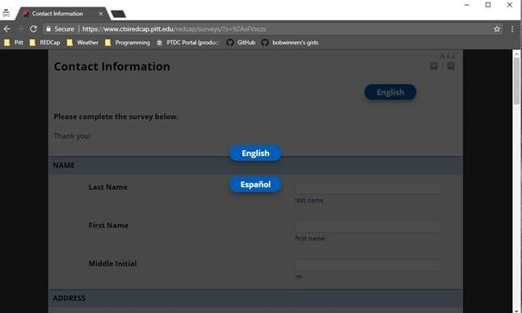
Multilingual forms
Before viewing the instrument, the individual had to select a language. Since the vast majority of participants speak English, this would increase “burden.”

Slide 35
Multilingual forms
It was better just to create a separate REDCap project with instruments in Spanish.
If the participant speaks Spanish, the coordinator goes to the Spanish project and puts REDCap in survey mode.
When the participant submits the form, the values are synchronized with the English (clinical) project. Therefore, all data values are still in one project for randomization and ease of analysis.

